Slide 1

GeoData WS2021/22 <group>
<name1>, <matno1> <name2>, <matno2> <name3>, <matno3>
(presentation: 7 mins max. / person + 5 mins discussion / group)

Slide 2
Task 01: Warming Stripes
Utilize temperature data collected from NRW stations that have been in operation since prior to 1950 and are still functioning to illustrate the impact of global warming by representing temperature variations above or below a specific benchmark temperature with colored stripes. With red and blue hues indicating warmer and cooler temperatures, respectively.

Slide 3
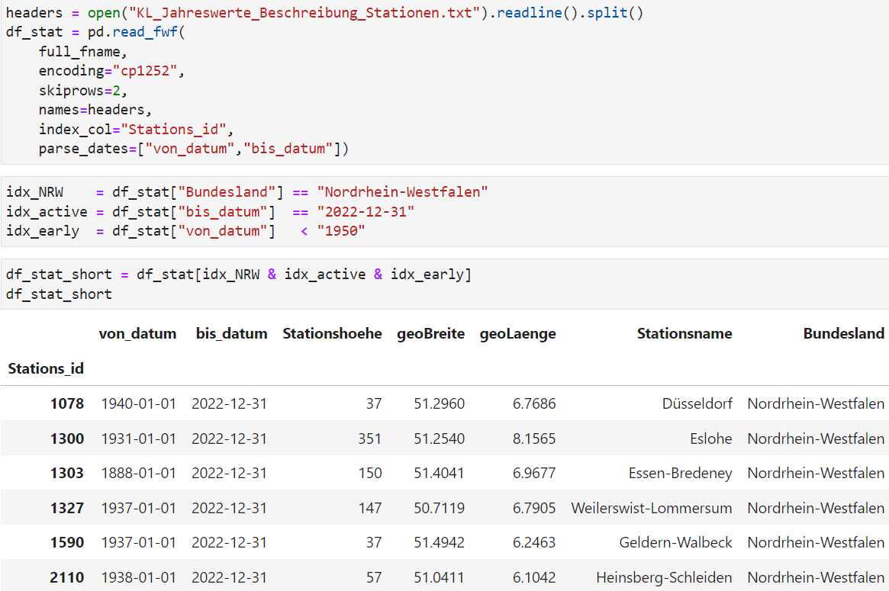
Sub-Task 1.1: Selecting the stations which are in NRW still active and started before 1950
First, we download the data as a txt file from DWD opendata. Then, we read the data which are located in NRW, still active and started before 1950 using Pandas.

Slide 4
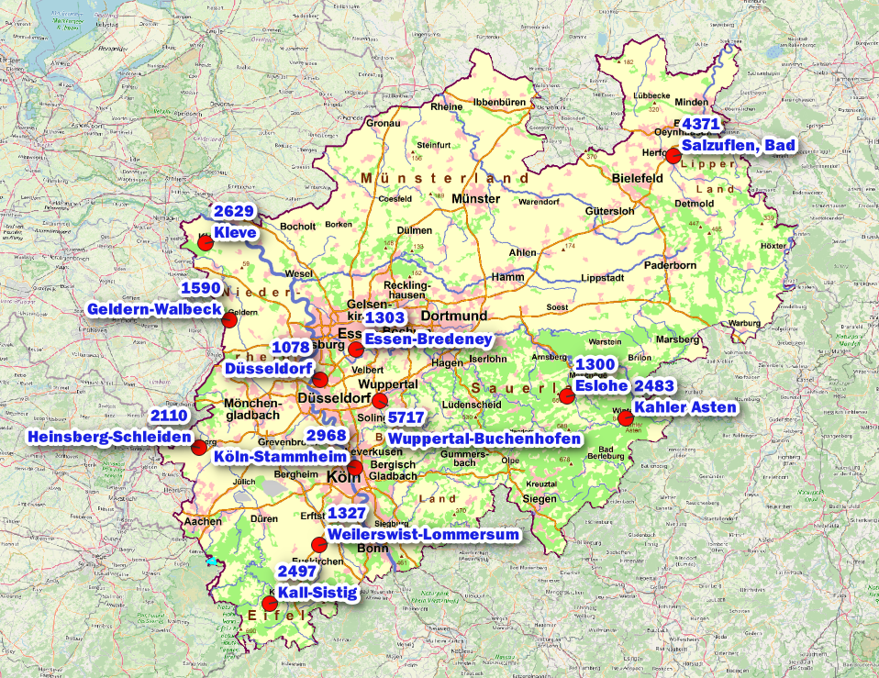
Sub-Task 1.2: create a geopackage layer and load it into QGIS
After creating a geopackage using geopandas, we load it into QGIS and create a designed map with NRW WMS service.

Slide 5
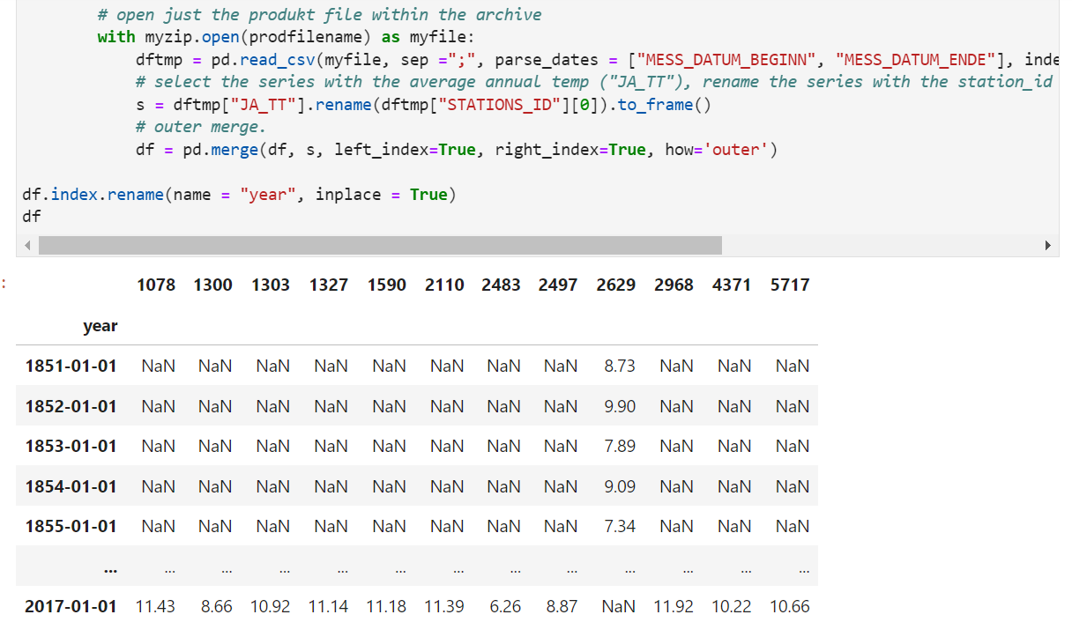
Sub-Task 1.3: download the annual temperature data from the KL data collection
After downloading the annual temperature data, we unzip them and read them using zipfile and pandas.

Slide 6
Sub-Task 1.4: plot the warming stripes
After downloading the annual temperature data, we unzip them and read them using zipfile and pandas.

Slide 7
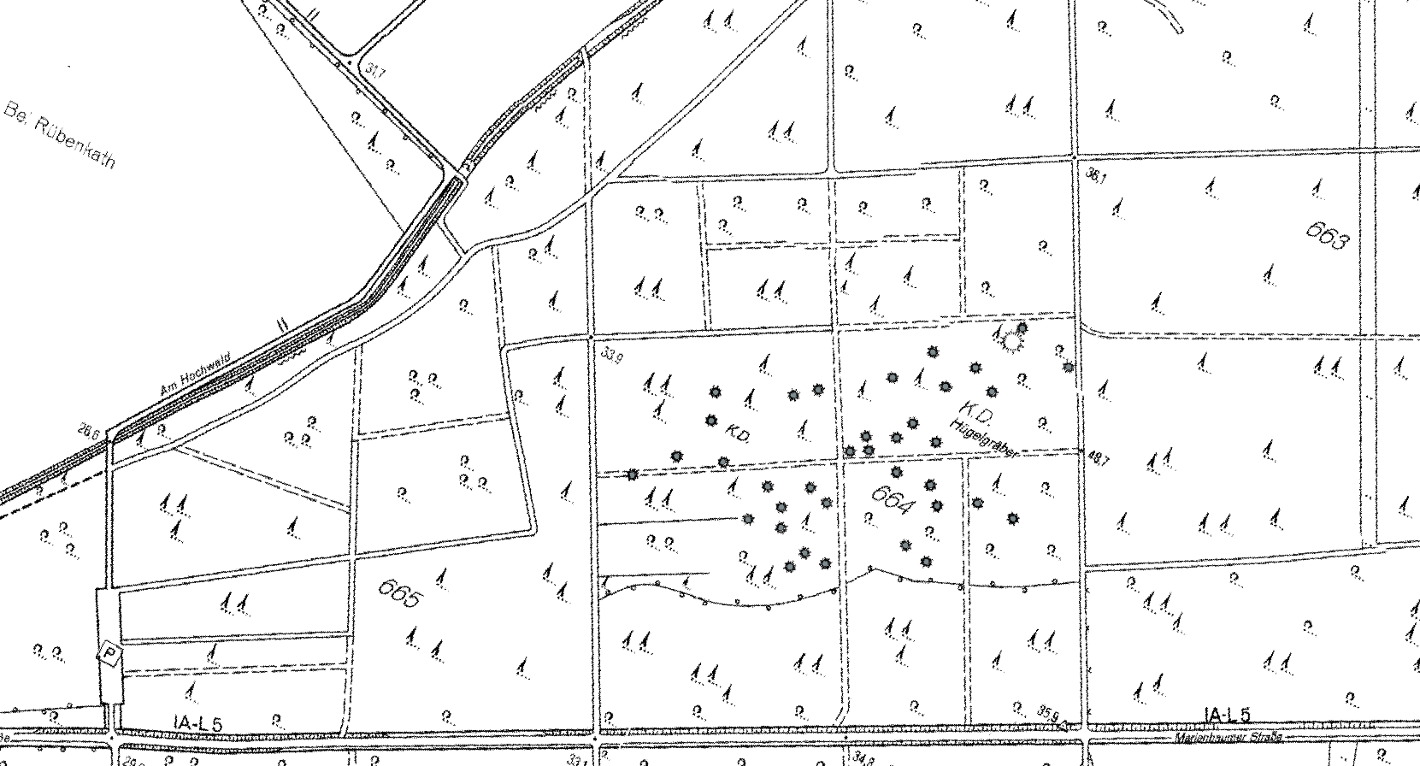
Task 02: Digitization: Burial Mounds in Uedemer Hochwald
In this task, we are going to georeference an image of Burial mounds in Uedemer Hochwald and create a hillshade model from the DTM layer. Also, we are going to measure the typical mound heights and search for weakly visible rectangular structures which are not paths.

Slide 8
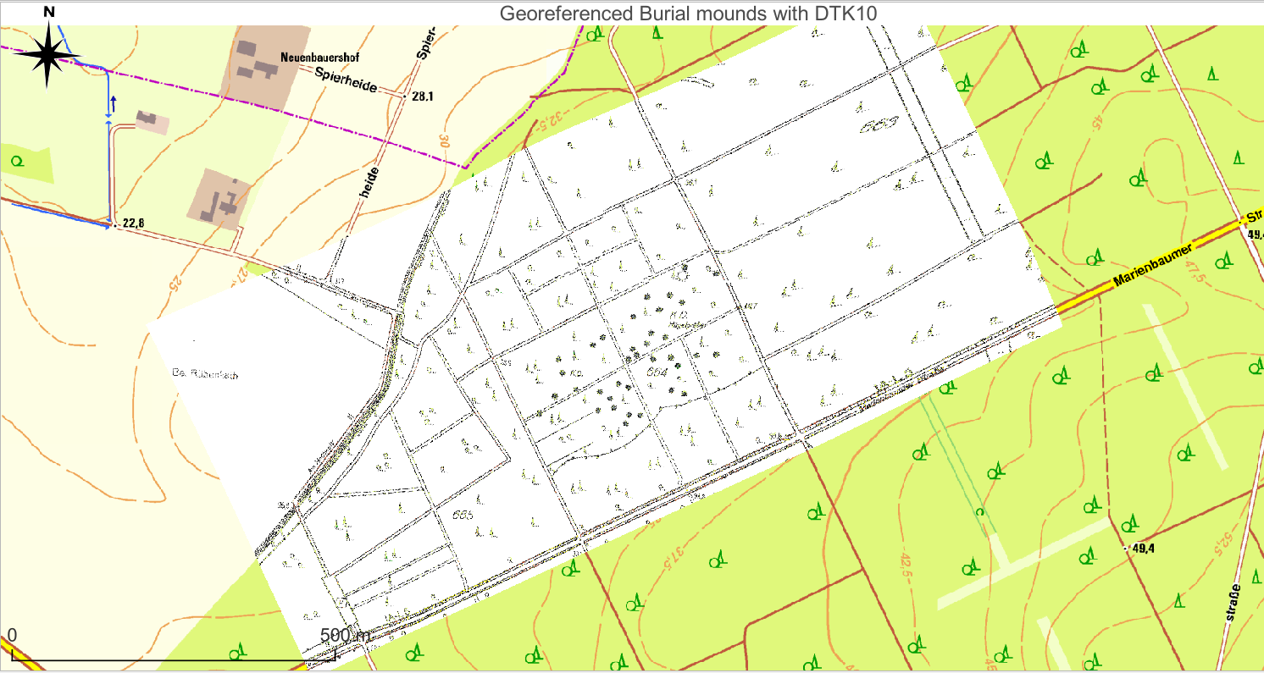
Sub-Task 2.1: Georeference the picture of the map provided.
Using the Georeference tool we select 20 points as land marks that matches the picture and the DTK10 map.

Slide 9
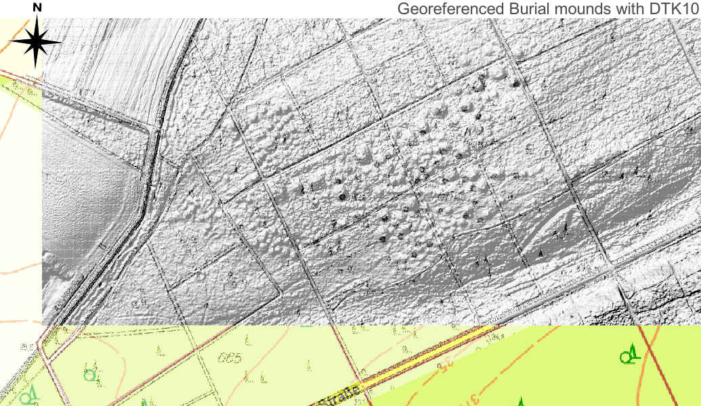
Sub-Task 2.2: Create a hillshade model from the DTM layer
To create a hillshade, we select Render type: Hillshade in Symbology and set the Z Factor to 20 to better show the landforms.
The georeferenced map shows the the burial mounds but a little bit shifted toward north-east direction. Also, the majority of the burial mounds are not represented in the map.

Slide 10
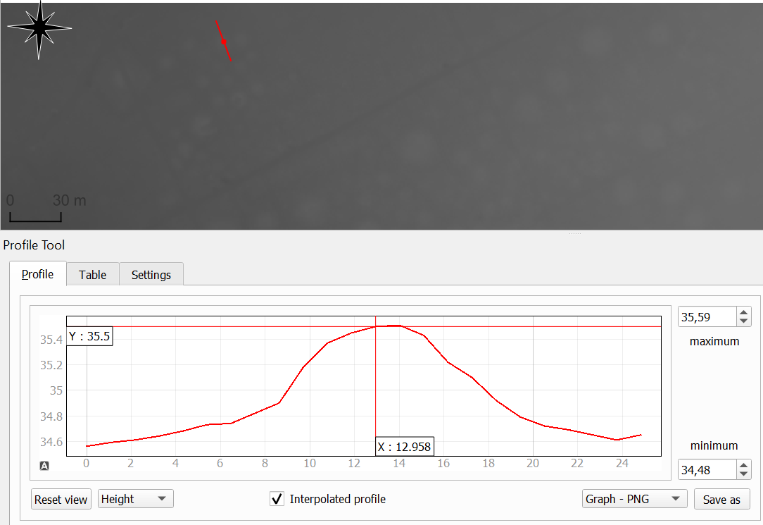
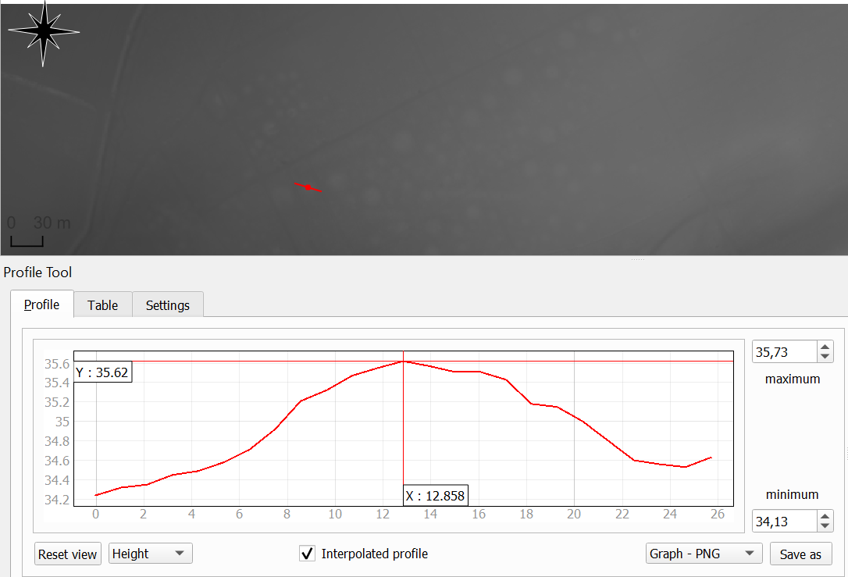
Sub-Task 2.3: Measure the typical mound heights relative to their direct environment
First, we install “Profile tool” plugin, then we measure the absolute height of the mounds and their surroundings by drawing a line over the mounds in the DTM layer. After that, we subtract the two values to get the typical mound height.
As we can see on these pictures, the typical heights is about 1 meter

Slide 11
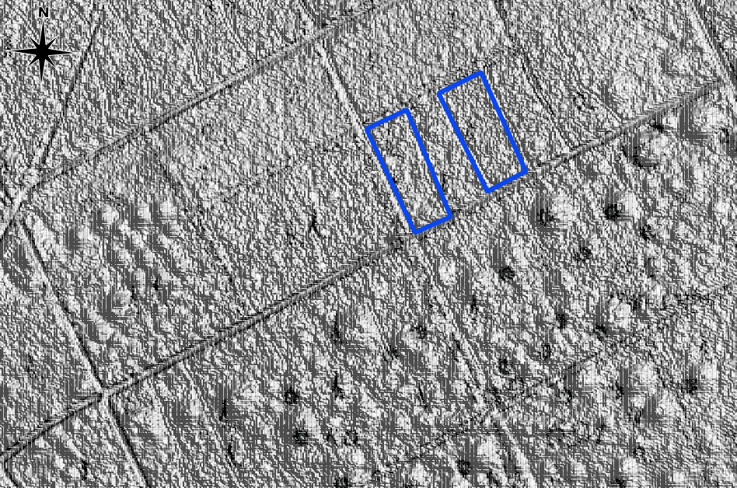
Sub-Task 2.4: Study the hillshade model in direction East-North-East of the burial mounds area
We start by setting the azimuth to 67.5° and altitude to 45° for East-North-East direction. Then, we create a new geopackage layer and set a polygon and save it. As we can see in this picture, we selected two rectangular.
The origin of these pattern is believed to be the result of a burial custom practiced by the Germanic tribes during the early Iron Age (750-450 BC).

Slide 12
Task 03:

Slide 13
Task 04: Earthquake Data Visualization
In this task, our goal is to determine earthquake danger zones around the world by visualizing earthquake data from 22/02/2021 until 23/02/2023.
Also, we are going to make a time series animation of the recent earthquake event that occurred in Turkiye. And finally, create a 3D model of a DEM image of the impacted zone.
The Earthquake data that we are going to use can be downloaded from earthquake.usgs.gov website by selecting the magnitude, date and geographic region. And the DEM image can be downloaded from srtm.csi.cgiar.org
All the data are also included in the folders.

Slide 14
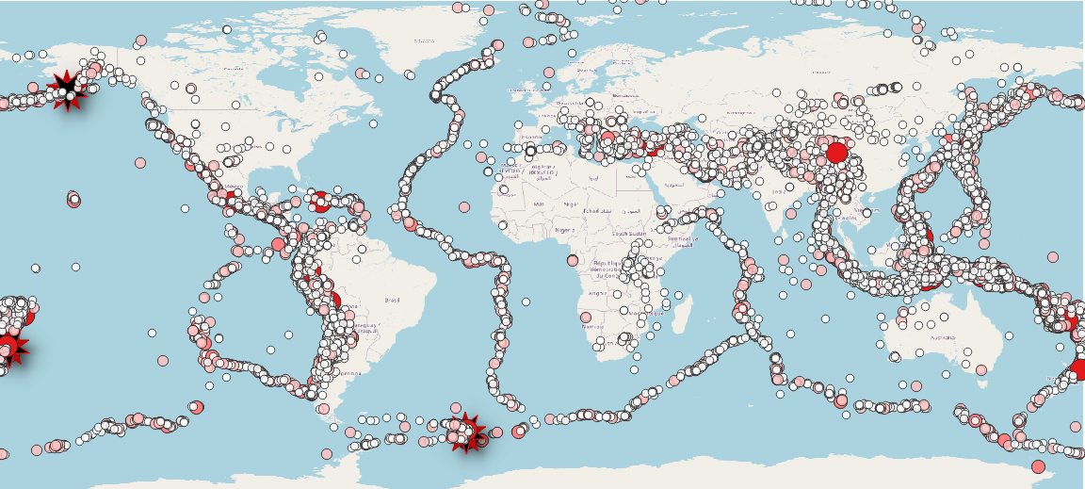
Sub-Task 4.1: Earthquake danger zones around the world
After plotting the data, we get this results that shows us the epicenter of earthquakes occurred in the last 2 years.
We can see that most seismic activity takes place at the boundaries between tectonic plates. The 3 stars shows the location of earthquakes with magnitudes of 8 or more.

Slide 15
Sub-Task 4.2: Time series animation Animation

Slide 16
4. etc. …
We import the data as a vector layer.
Then, in symbology we create 5 classes with fixed interval. Set the color and transparency of each class to make it easy to distinguish.

Slide 17
<matno>: Your Personal View
Biggest challenges?
Lessons learned?
Whatever you want to say related to course, …

Slide 18
<matno>: Self-Assessment, Part 1 (give short answers)
What is your role in the group?
<e.g. master of disaster>
Which (sub)tasks are you responsible for?
<e.g. video, NDVI, …>
With whom have you been cooperating?
<e.g. John Doe (video), Iris Incredible (NDVI), …>

Slide 19
<matno>: Self-Assessment, Part 2 (On a scale from 1 (poor) to 5 (very good))
What is your personal knowledge gain?
[1-5]
How do you rate your commitment?
[1-5]
How difficult is your task?
[1-5]

